Slide 1

Metro Shell
ftware
© 2011 ftware. All rights reserved.

Slide 2
About
Metro Shell is a Desktop Customizing application made over .NET Framework for Window 7. It’s a Metro inspired application with seamless integration of Widgets, Internet, and some useful features. It’s also extensible, means that you can create Widgets, that get into Tiles Screen, if you know C# or VB.NET programing in WPF platform.

Slide 3
Metro Shell
Overview
Metro Taskbar
StartBar
Tiles Screen
Widgets
Pinning Apps and Webs
Customizing
Settings
Extending Metro Shell
Resources

Slide 4
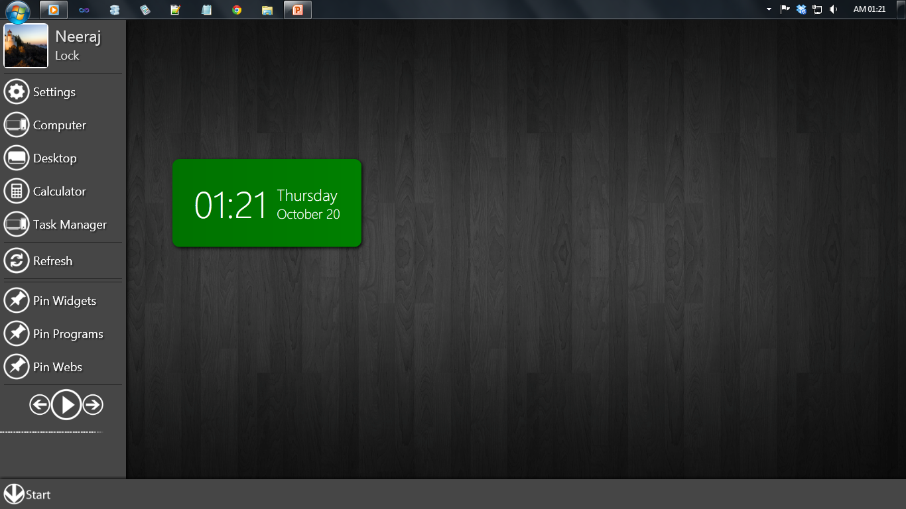
Overview
Tiles Screen
Startbar
User Tile
Widget
Pinning Functions
Functions, Settings and general everyday tasks
Music Player
Taskbar

Slide 5
{TITLE}

